Slide 1
Discovering faster matrix multiplication algorithms with reinforcement learning
Nov 2022

Slide 2
Matrix multiplication is ubiquitous
Scientific computing: NLA, NPDE
Statistical computing: MCMC, EM
Machine learning
…
LAPACK
BLAS library:
BLAS is a collection of low-level matrix and vector arithmetic operations (“multiply a vector by a scalar”, “multiply two matrices and add to a third matrix”, etc ...)

Slide 3

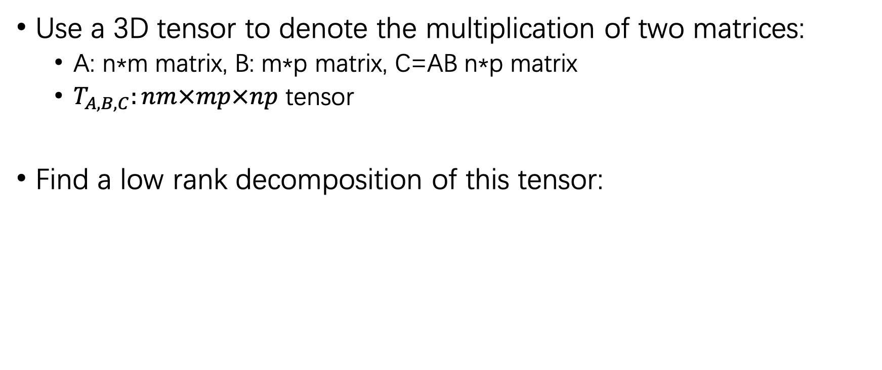
Matrix multiplication as tensor decomposition
Use a 3D tensor to denote the multiplication of two matrices:
A: n*m matrix, B: m*p matrix, C=AB n*p matrix
$T_{A,B,C}:nm×mp×np$ tensor
Find a low rank decomposition of this tensor:

Slide 4
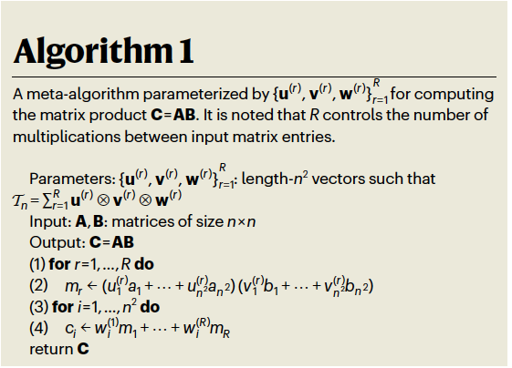
Matrix multiplication as tensor decomposition

Slide 5
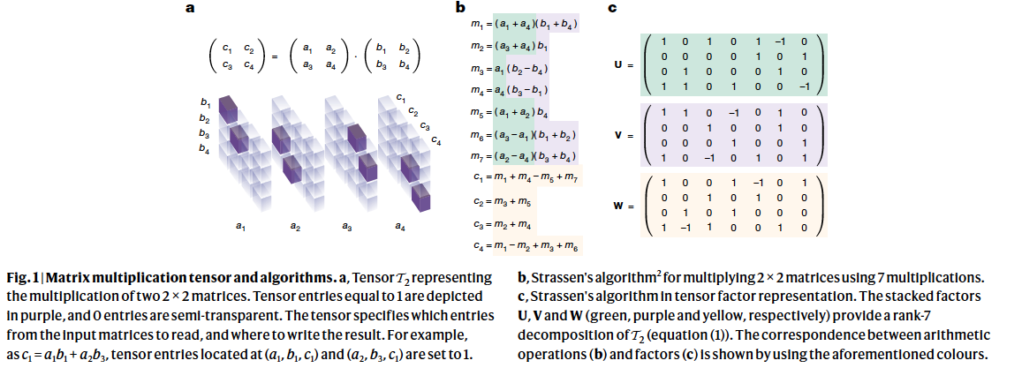

Strassen algorithm
Asymptotic complexity: ${O\left(n^{2.8}\right) }_{}$

Slide 6
Practical issue
Is Strassen algorithm really used in practice?
Not really, reasons include:
Large constant factor
Sparse structured matrix
Parallelism
Caching and architecture specific quirks

Slide 7
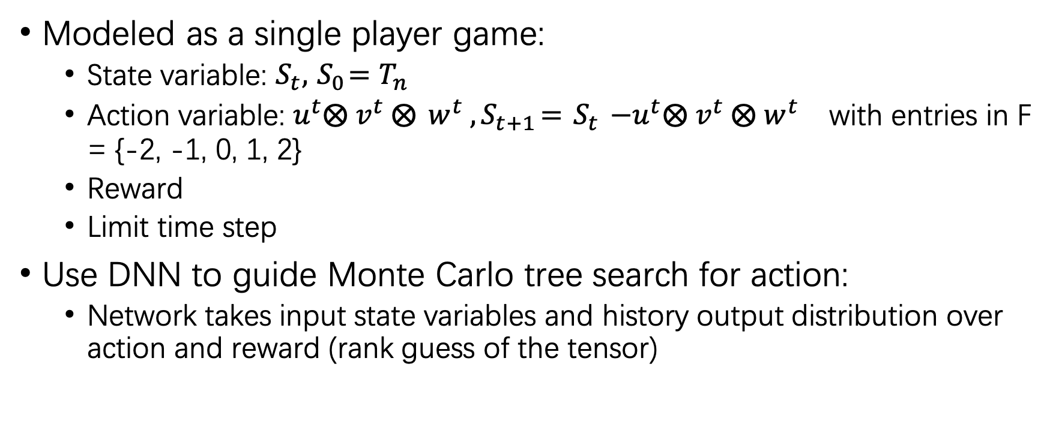
Tensor Game
Modeled as a single player game:
State variable: ${S_{t}, { S}_{0}=T}_{n}$
Action variable: ${u^{t}⨂{ v}^{t} ⨂{ w}^{t}{ , S}_{t+1}={ S}_{t} −u^{t}⨂{ v}^{t} ⨂{ w}^{t}}_{}$ with entries in F = {-2, -1, 0, 1, 2}
Reward
Limit time step
Use DNN to guide Monte Carlo tree search for action:
Network takes input state variables and history output distribution over action and reward (rank guess of the tensor)

Slide 8
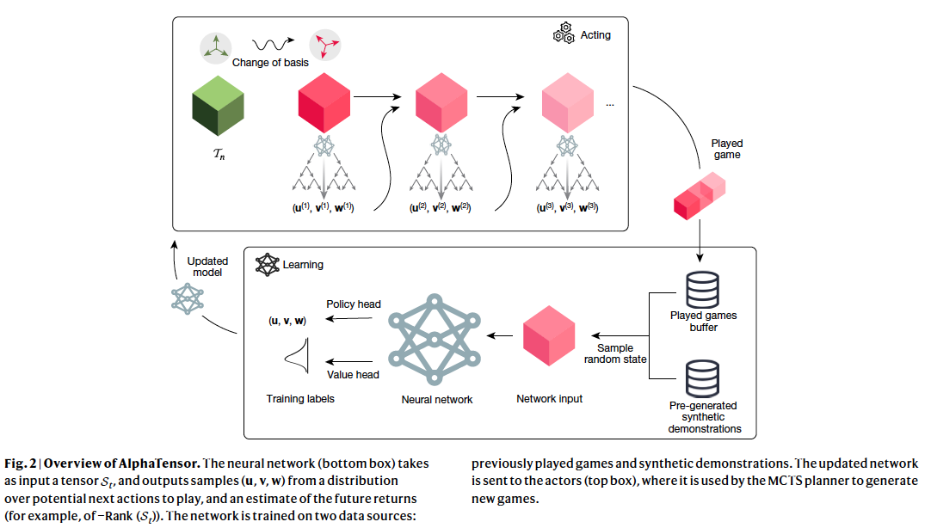
Tensor Game

Slide 9
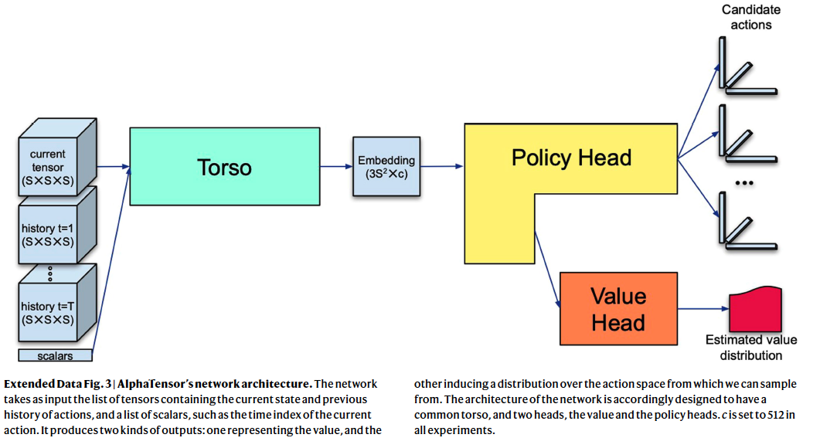
Network architecture

Slide 10

Data generation
Target tensor
Synthetic data
Data augmentation: basis change:

Slide 11
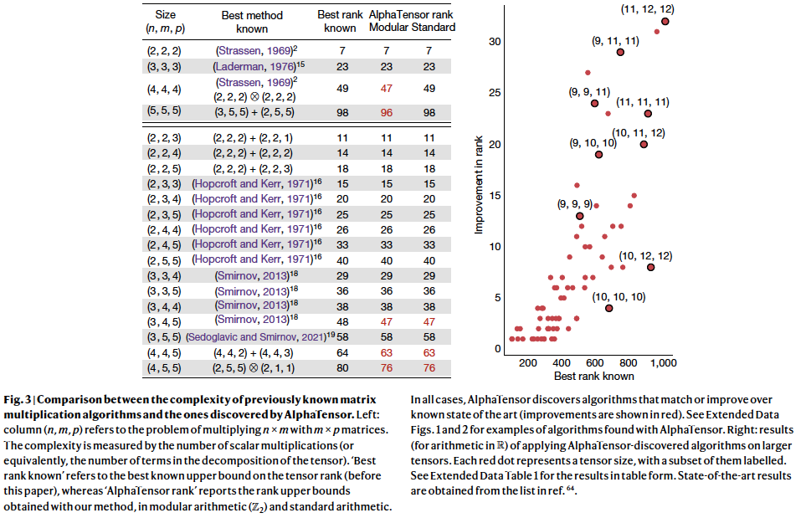
Algorithm discovery

Slide 12
Hardware Performance
The test case is a matrix multiplication of size 8192, considering as a 4-by-4 blockwise with each block of size 2048. Finding the algorithm which provides the best combination of these blocks to provide the best acceleration
Two hardwares are considered: Nvidia V100 GPU and Google TPU v2
The baseline is the cuBLAS for GPU
The acceleration also scales to larger dimension matrices

Slide 13
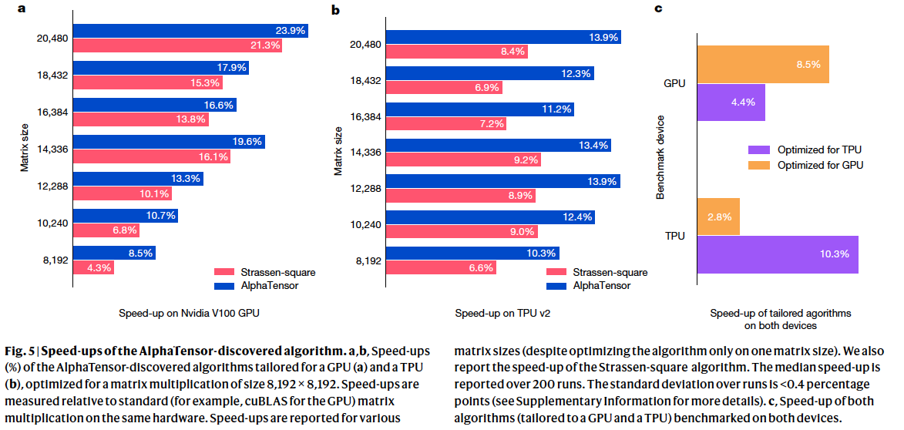
Hardware Performance

Slide 14
Related work
Continuous based approach: not exact multiplication
Symmetry of matric multiplication

